Slide 1
INTRUSION DETECTION IN IOT SYSTEMS

Slide 2






Our Team
Akshat Khandelwal
Jagath Haren
Jayalakshmi. M
Jayraj Chiragkumar Shah
Jhon Alsten Tauro
K. Thrishul
Computer Science and Engineering
AIET Moodbidri, India
Computer Science and Engineering
AIET Moodbidri, India
Computer Science and Engineering
AIET Moodbidri, India
Computer Science and Engineering
AIET Moodbidri, India
Computer Science and Engineering
AIET Moodbidri, India
Computer Science and Engineering
AIET Moodbidri, India

Slide 3
Agenda
01
Introduction
02
Statement of the problem
03
Objectives
04
Methodology
05
Applications
06
Conclusion
07
References

Slide 4

Introduction
Intrusion Detection Systems (IDS)
Intrusion detection is the process of identifying and responding to malicious activity targeted at resources
IDS is a system designed to test/analyze network system traffic/events against a given set of parameters and alert/capture data when these thresholds are met.
IDS uses collected information and predefined knowledge-based system to reason about the possibility of an intrusion.
IDS also provides services to cop with intrusion such as giving alarms, activating programs to try to deal with intrusion, etc.

Slide 5

Statement of the problem
The current cloud computing paradigm will hardly be able to meet the requirements of low latency and scalability to support intrusion detection.
To face this challenge, it is possible to approximate the intrusion detection function processing to small devices and objects, taking advantage of the resources available on small devices that populate the edge of the network.

Slide 6
Objectives
Intrusion detection systems have been studied over two decades, mostly employing traditional data mining and machine learning techniques that require an offline phase for model training on large amounts of data
Understand the concept of IDS/IPS and NOVELTY DETECTION:
The IoT network creates numerous opportunities for novel attacks that can compromise information and systems integrity.
.
Three data stream novelty detection techniques applied to the intrusion detection problem and proposes IDSA-IoT, a novel implementation architecture.

Slide 7
What is an Intrusion Detection System?
Defined as the tools, methods, and resources to help identify, assess, and report unauthorized or unapproved network activity.
An IDS detects activity in traffic that may or may not be an intrusion.
IDSes can detect and deal with insider attacks, as well as, external attacks, and are often very useful in detecting violations of corporate security policy and other internal threats.

Slide 8
Novelty Detection
Novelty Detection (ND) is the recognition that an example differs in some way from the previous examples.
It allows the recognition of new patterns, which may either trigger the emergence of a new concept, the evolution of a known concept, or the presence of noise.
ND offers a valuable technique in many ways when dealing with intrusion detection.

Slide 9
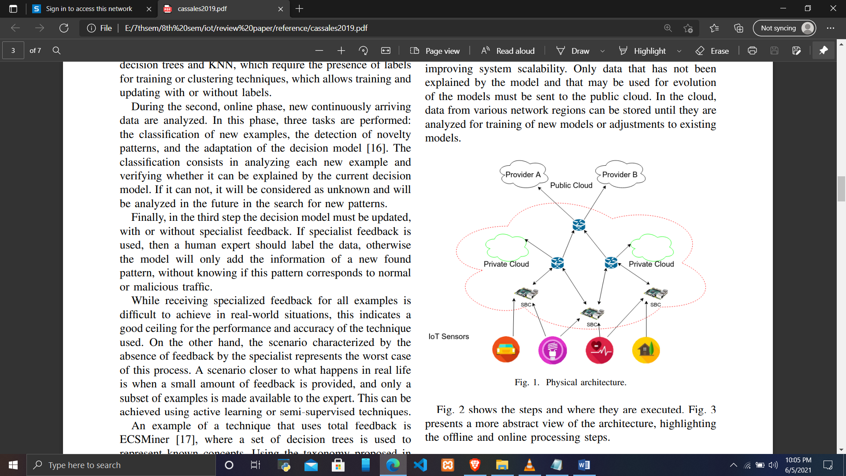
PROPOSED ARCHITECTURE
Fig. 1. Physical architecture.

Slide 10
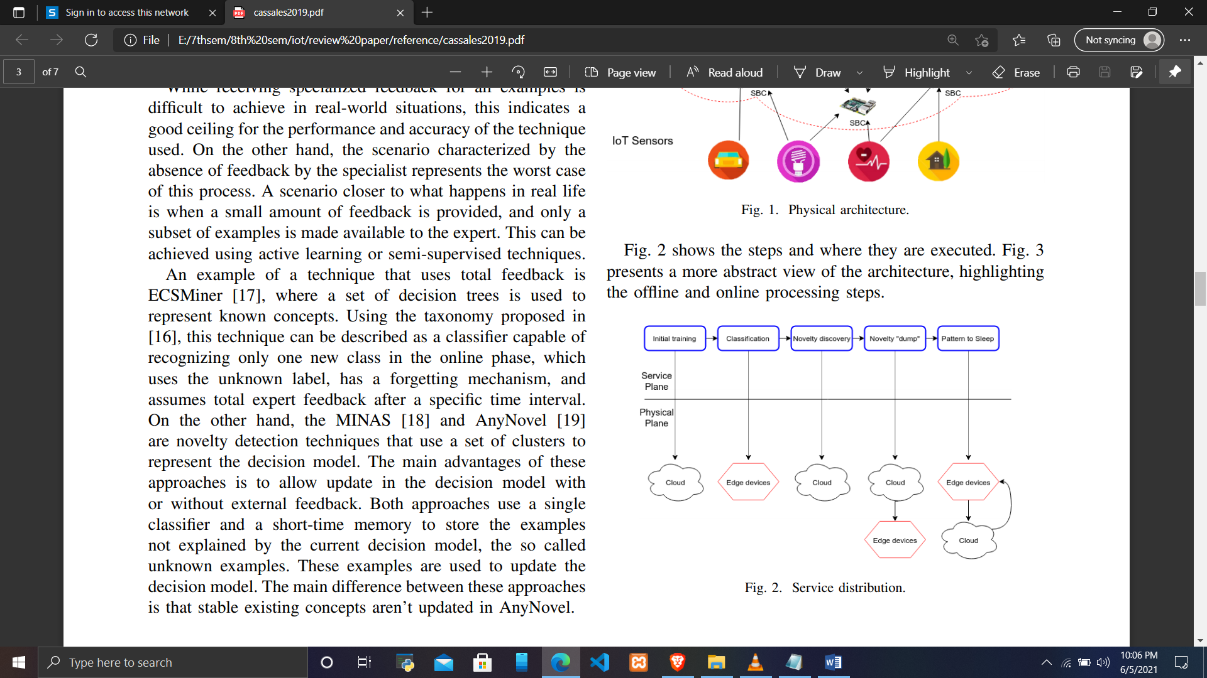
Fig. 2. Service distribution. .

Slide 11
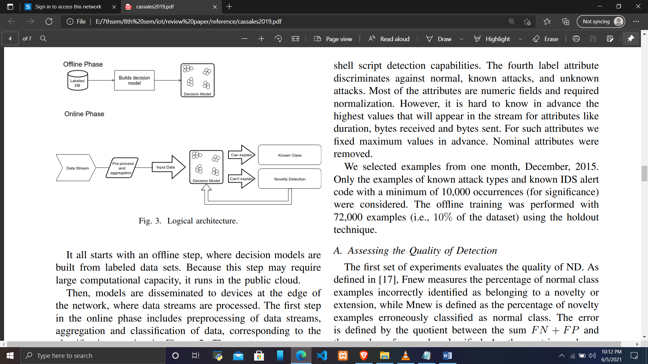
Fig. 3. Logical architecture.

Slide 12
EXPERIMENTS
Assessing the Quality of Detection
Performance in Constrained Devices
Summary of Experiments

Slide 13
A. Assessing the Quality of Detection
The first set of experiments evaluates the quality of ND. Fnew measures the percentage of normal class examples incorrectly identified as belonging to a novelty or extension, while Mnew is defined as the percentage of novelty examples erroneously classified as normal class.
We have performed experiments aiming to evaluate the technique ECSMiner with varying amount of labels delivered while maintaining the delay.

Slide 14
B. Performance in Constrained Devices
This experiment aims at evaluating the feasibility of evaluated methods running on devices with constrained resources.
We implemented an isolated network with a Switch 3Com Baseline 2824 with 24 10/100/1000 ports, a Raspberry Pi and a notebook with a Core i5-7200U 2.5GHz processor and DDR4 2133MHz 8GB memory.
A producer process running on the notebook replayed the contents of the dataset in fthe form of data streams with controlled parameterized rates. The data was posted on a Kafka server running on the same notebook.
A Raspberry Pi 3 card consumed Kafka data and performed classification and ND.The producer has three parameters (R, S, I), where R (Base rate) is the starting rate of examples published in a kafka topic per second.
Every I seconds, the rate will be increased by S units, until 80MB of data is generated, for each technique, the Base Rate that produced the best execution time as well as the amount of memory it consumed.

Slide 15
C. Summary of Experiments
In summary, these experiments provided insights about the techniques and the dataset.
In a scenario where processing power and specialist feedback are abundant, ECSMiner is the best option. However, neither of these requisites is easily fulfilled in IoT scenarios.
The second smallest memory consumption , indicates a good alternative if the classification performance could be improved.

Slide 16

CONCLUSION
An intrusion detection system architecture for IoT environments was presented. The architecture makes combined use of a large computational capacity infrastructure, such as the public cloud, and distributed resources at the edge of the network.
Content Here
Content Here
Get a modern PowerPoint Presentation that is beautifully designed.

Slide 17
REFERENCES
R. Mitchell and I.-R. Chen, “A survey of intrusion detection techniques for cyber-physical systems,” ACM Computing Surveys (CSUR), vol. 46, no. 4, p. 55, 2014.
01
50%
02
M. Sheikhan and H. Bostani, “A hybrid intrusion detection architecture for internet of things,” in 8th Intl. Symp. on Telecommunications (IST), Sept 2016, pp. 601–606.
75%
P. Perner, “Concepts for novelty detection and handling based on a case-based reasoning process scheme,” in Advances in Data Mining. Theoretical Aspects and Applications. Springer, 2007, pp. 21–33
03
50%
04
J. Gama, Knowledge Discovery from Data Streams. CRC Press Chapman Hall, 2010.
75%

Slide 18
THANK YOU

